Slide 1

Distributed Video Streaming App with Kafka

Slide 2
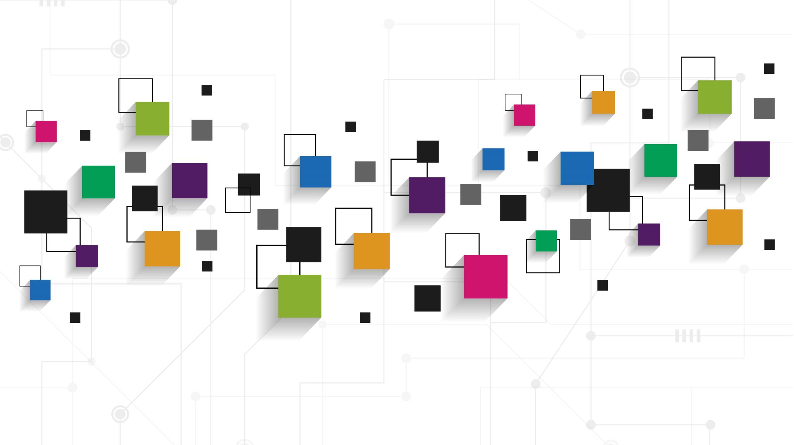
Basic Function of the System
Creating the Distributed Video Streaming App which allows users to sign up and login on separate browsers to Upload and stream the videos, The admin user is able to control the users in admin panel. This design a system that could handle large volumes of videos in real-time and provide a scalable, fault-tolerant platform to store and process data. We have used kafka for stream the data and Minio object storage database for store the videos as byte object.

Slide 3
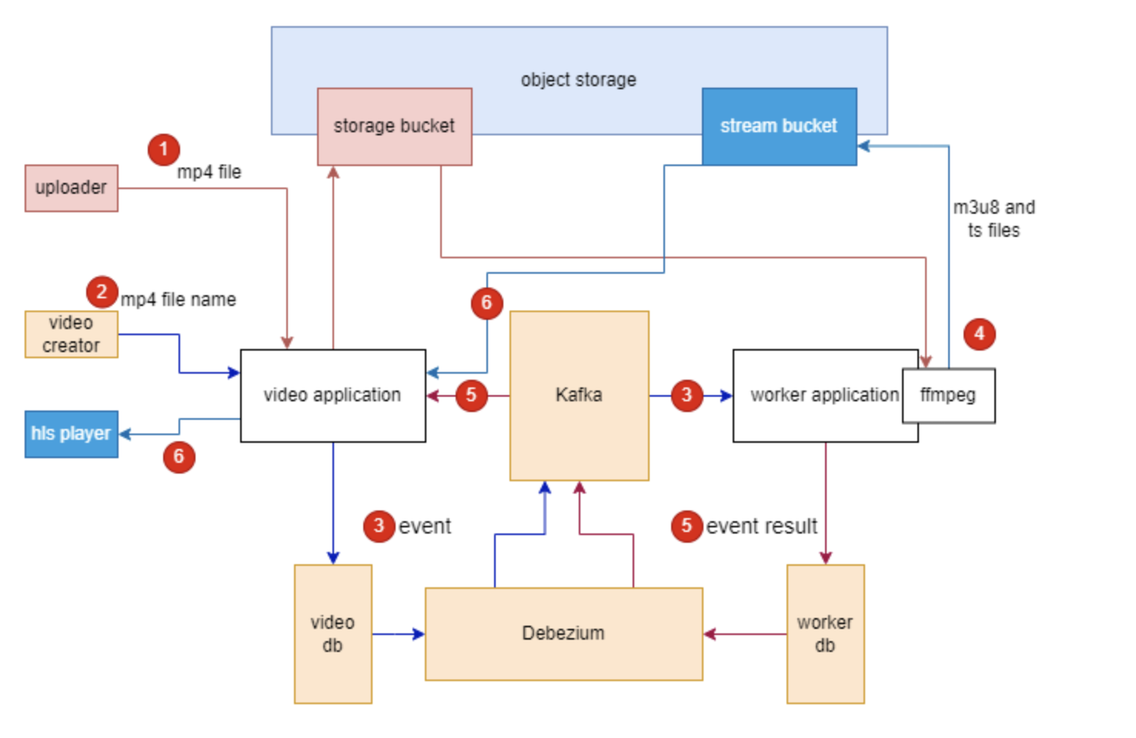
Architecture Diagram

Slide 4
Architecture of System
The Videos Stream application client-side allows authenticated users to upload the videos as mp4.
In video db, store this upload event and save this video on the Mino object DB on particular location, Whenever any new rows of record added into the video db , the kafka-upload-event producer produce that upload event message.
This message contains the location of the video on Mino object DB and upload event details. Later, kafka-upload-event consumer subscribe this video upload event and load this video from the Mino object DB location to convert into the stream format and save that consumed event into the worker db.
Now, The authenticated users to able to get the stream url of the each uploaded video by filename from the app.

Slide 5
Design of simplified UI and Design Components
Development UI
UI
Create the login page and admin dashboard page , upload and stream pages for the users developed by with help of Html, CSS, Vue js and Spring thymeleaf.
HTML
The HyperText Markup Language or HTML is the standard markup language for documents designed to be displayed in a web browser.
CSS
CSS is the language we use to style an HTML document. CSS describes how HTML elements should be displayed.
Thymeleaf
Thymeleaf is a modern server-side Java template engine that emphasizes natural HTML templates that can be previewed in a browser by double-clicking, which is very helpful for independent work on UI templates without the need for a running server. It’s easy to integrate with the Spring MVC.

Slide 6
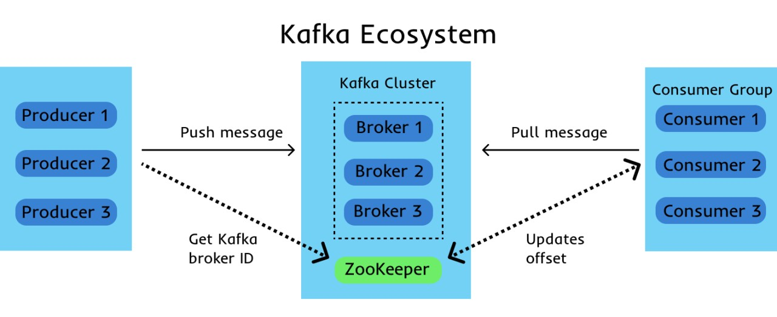
Kafka Distributed System
Apache Kafka is a distributed event store and stream-processing platform. It is an open-source system developed by the Apache Software Foundation written in Java and Scala. The project aims to provide a unified, high-throughput, low-latency platform for handling real-time data feeds.

Slide 7
Development Frameworks & Distributed Technologies
Back End
Use Java and spring boot framework to create the Video Streaming api (Upload and Stream the Videos).
JAVA
Java is a class-based object-oriented programming language which was first released by Sun Microsystems in 1995. it has become one of the most widely used programming languages in the world, with applications ranging from desktop and web applications to mobile and embedded systems.
Spring Boot
Spring Boot is an open-source Java framework which helps to ease and accelerate the process of developing a web application . It was developed by Pivotal Software, the same company behind the well-known Spring Framework. It also provides a set of starter dependencies that developers can use to quickly add functionalities to their applications. Which is the most real time using framework for creating the Apis.
Produce and Consume Messaging
Apache Kafka is a distributed event store and stream-processing platform. It is an open-source system developed by the Apache Software Foundation written in Java and Scala. The project aims to provide a unified, high-throughput, low-latency platform for handling real-time data feeds.
Database
MinIO is an object storage system. It is capable of working with unstructured data such as photos, videos, log files, backups, and etc, . It’s the Distributed databases and It supports data replication, fault tolerance, scalability, concurrency and API compatible with the Amazon S3 cloud storage service.
Docker
Docker is a platform designed to help developers build, share, and run container applications. We handle the tedious setup, so you can focus on the code. Using Docker to create,run and deploy all instances automatically by docker compose files instead of starting one by one manually.

Slide 8
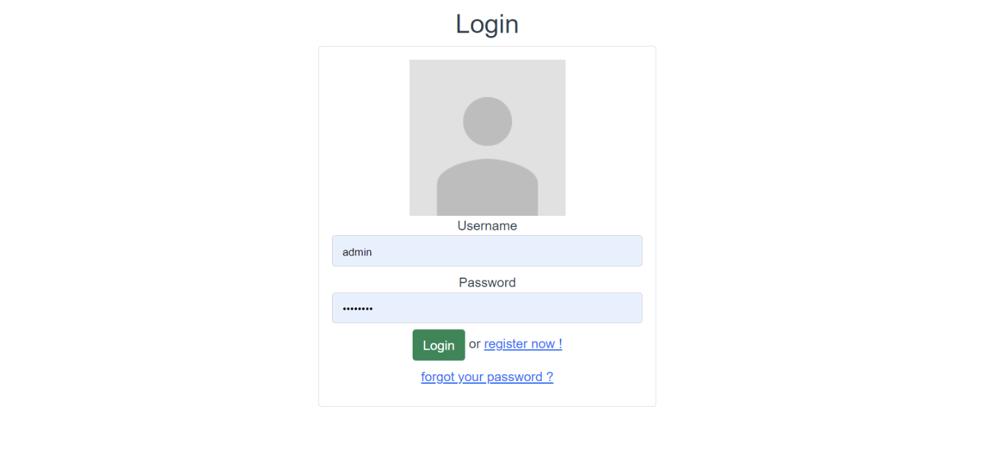
Login Page

Slide 9
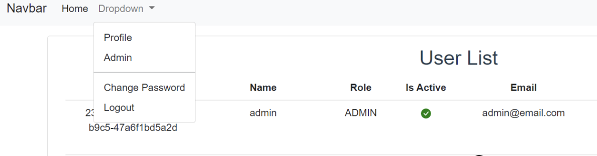
Admin DashBoard

Slide 10
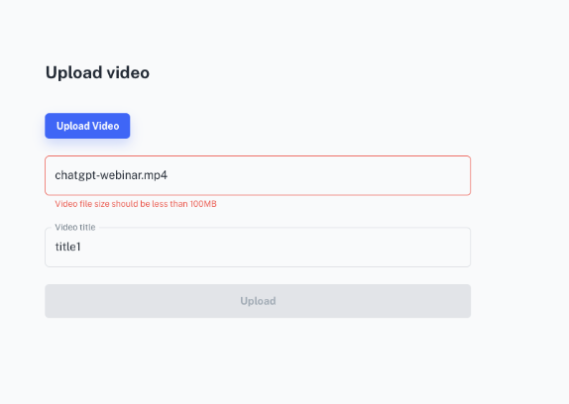

Slide 11
Reference Materials
https://spring.io/projects/spring-boot
ttps://spring.io/projects/spring-kafka
https://kafka.apache.org/
https://www.java.com/en/download/help/whatis_java.html
https://min.io/

Slide 12
THANK YOU

